Slide 1
Automation Training Selenium-Ruby-Cucumber Day 6
Frank Sejas

Slide 2
Agenda
Setup Environment
Run samples to verify correct setup

Slide 3
Setup Environment
Download RubyMine https://www.jetbrains.com/ruby/specials/rubymine/rubymine.html?gclid=Cj0KCQjwu_jYBRD8ARIsAC3EGCL32QwUQiHiKFZmkAvfJK96RStSoA8yrPPnR3jatUkVUNqRWWvumxQaAsyKEALw_wcB&gclsrc=aw.ds.ds&dclid=CIutvKzvy9sCFUGrAQod9IwPGQ
SDK Installers Download https://rubyinstaller.org/downloads/

Slide 4
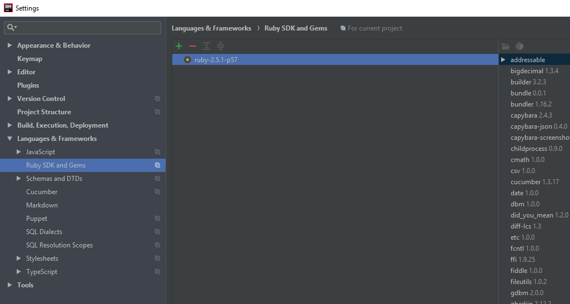
Setup Environment
Go to File>Settings>Language & Frameworks - Ruby SDK and Gems

Slide 5
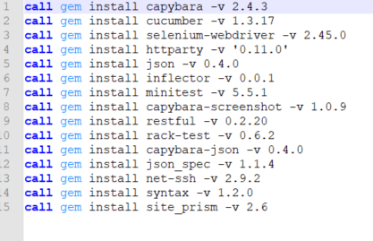
GEMS
Install necessary GEMS

Slide 6
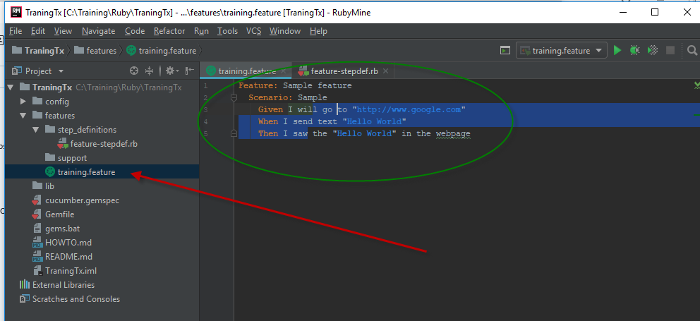
Samples
Create feature file

Slide 7
Step Definitions
require 'selenium-webdriver' Given(/^I will go to "([^"]*)"/) do |url| chromedriver_path = File.join(File.absolute_path('c:/Selenium', File.dirname(__FILE__)),"","chromedriver.exe") Selenium::WebDriver::Chrome.driver_path = chromedriver_path @driver = Selenium::WebDriver.for :chrome @driver.navigate.to url end When(/^I send text "([^"]*)"$/) do |text| element = @driver.find_element(:id, 'lst-ib').send_keys text, :enter end When(/^I saw the "([^"]*)" in the webpage$/) do |textVerification| begin @wait.until { @driver.find_element(:tag_name => "body").text.include?(textVerification)} rescue puts "Failure! text is not present on the page" end @driver.quit end

